Slide 1
WEATHER MONITORING SYSTEM
TEAM NO : 2
NAME AND ROLL NO :MAHARAJAN – 19BCS089
SIVA PRAKASH – 19BCS072
BHARAT SHANKAR – 19BCS076
PRAVEEN – 19BCS094
DOMAIN: INTERNET OF THINGS

Slide 2
ABSTRACT
The system proposed is an advanced solution for monitoring the weather conditions at a particular place and make the information visible anywhere in the world. The technology behind this is Internet of Things (IoT), which is an advanced and efficient solution for connecting the things to the internet and to connect the entire world of things in a network. Raspberry Pi, sensors and automotive electronic equipment. The system deals with monitoring and controlling the environmental conditions like temperature, relative humidity and CO level with sensors and sends the information to the web page and then plot the sensor data as graphical statistics. The data updated from the implemented system can be accessible in the internet from anywhere in the world.

Slide 3
Literature Survey
TITLE
1. Development of IoT Based Weather Reporting System
2. Internet of Things (IOT) based Weather Monitoring System
3. Smart weather monitoring and real time alert weather and climate changes like system using IoT
4. Environment Monitoring System using Raspberry-Pi
AUTHOR AND JOURNAL
1.A F Pauzi and M Z Hasan, International Conference on Technology, Engineering and Sciences (ICTES) 2020
2. Girija C, Andreanna Grace Shires, Harshalatha H , Pushpalatha H P , International Journal of Engineering Research & Technology (IJERT) 2018
3. Yashaswi Rahut , Rimsha Afreen, Divya Kamini, SRM Institute of Science and temperature, humidity, wind Technology. IRJET - vol. 05, issue 10, Oct 2018.
4.Gaurav Jadhav, Kunal Jadhav, Kavita Nadlamani , R.H. Sapat College of Engineering, Management Studies and Research. IRJET - vol. 3, issue 4, Apr 2016.

Slide 4
LITERATURE SURVEY
https://ieeexplore.ieee.org/abstract/document/9074332
Issue 10 And Issue 4 available on info@pdfcoffee.com
These are some of the links to get detailed information why we chose the project.

Slide 5
LIMITING FACTORS OF EXISTING SYSTEM
The current system always faces problems such as delay in warning people about bad weather and sudden changes in the forecast.
The instruments used in the existing systems are expensive and add up to the already high cost of installation and maintenance.
Data that is collected by the instruments needs to be manually transferred from the logger to a laptop or computer via a cable.

Slide 6
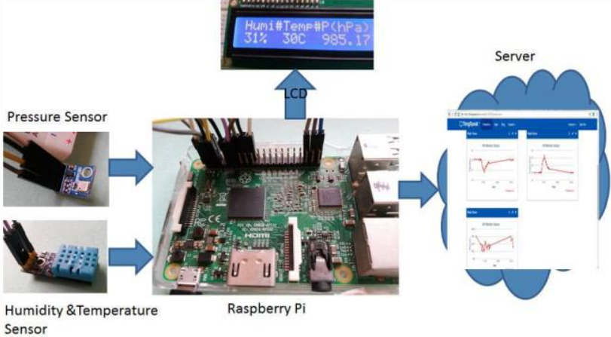
PROPOSED SYSTEM
❏

Slide 7
CONTINUATION
This IoT based project has four sections. Firstly DHT11 sensor senses the Humidity & Temperature Data and BM180 sensor measures the atmospheric pressure.
Secondly Raspberry Pi reads the DHT11 sensor module’s output by using single wire protocol and BM180 pressure sensor’s output by using I2C protocol and extracts both sensors values into a suitable number in percentage (humidity), Celsius scale (temperature), hectoPascal or millibar (pressure).
Thirdly, these values are sent to ThingSpeak server by using inbuilt Wi-Fi of Raspberry Pi 3. And finally ThingSpeak analyses the data and shows it in a Graph form. A LCD is also used to display these values locally.

Slide 8
FEATURES OF CONTEMPORARY SYSTEM
Install this setup anywhere and can monitor the weather conditions of that place from anywhere in the world over the internet.
It will not only show the current data but can also show the past values in the form of Graphs.
❏

Slide 9
TECHNOLOGY STACK
HARDWARE
Raspberry Pi
Pressure Sensor(BM180)
Humidity & Sensor(DHT 11)
LCD MONITOR
JUMPER WIRES
SOFTWARE
THINGS SPEAK(API GENERATOR WEB.WE CAN INTEGRATE IT WITH RASPBERRY PI)
PROGRAMMING LANGUAGE:PYTHON

Slide 10
References
https://pdfcoffee.com/literature-survey-on-weather-monitoring-system-using-raspberry-pi-pdf-free.html
https://ieeexplore.ieee.org/abstract/document/9074332
https://youtu.be/FSqlu1osia8

